Slide 1

Revving Into The Future : Car Price Prediction ◀️🔮

Slide 2
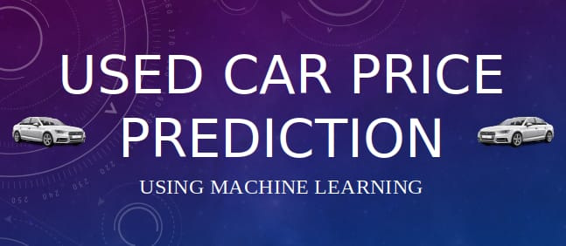
PROBLEM STATEMENT

Slide 3
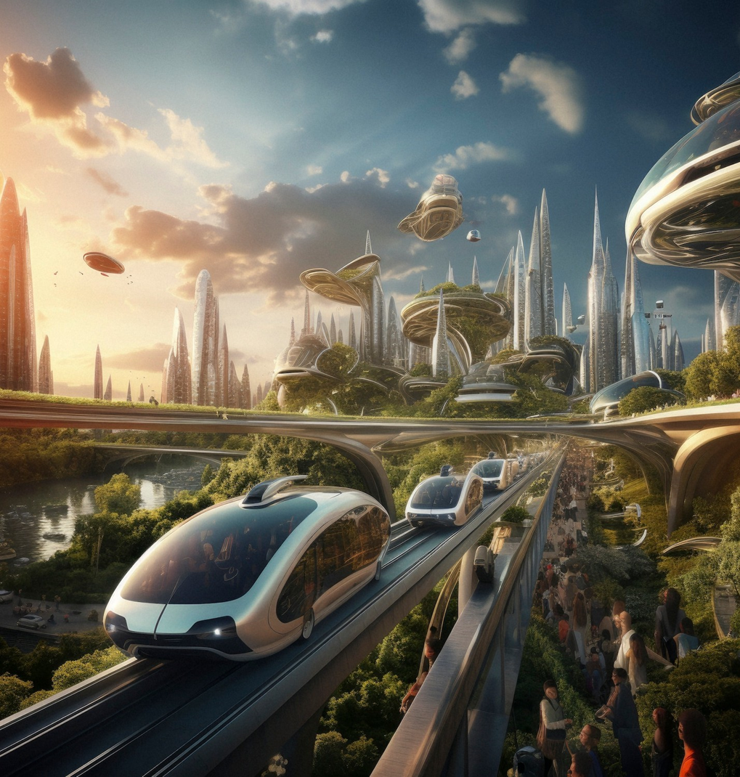
WELCOME TO THE FUTURE
In this presentation, we will explore the exciting world of . Get ready to dive into the future of car valuation and pricing strategies.

Slide 4
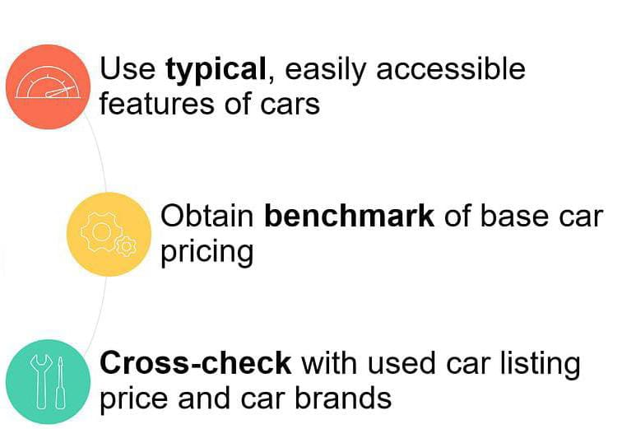

Used Car Price Prediction

Slide 5

What to Avoid When Buying a Used Car
Failing to line up financing before shopping
Shopping based on monthly payments alone
Foregoing the test drive
Not having car checked by a mechanic
Making initial negotiations in person
Buying based on looks
Not running a vehicle history report

Slide 6
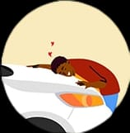






HOW TO CHOOSE THE MOST RELIABLE USED CARS
Expectation
Know Make
Know Model
Know Trim
Reality
Previous Owners Love Towards Vehicle Do Matter
Inspect Vehicle 360 Degree
Looks Can Be Deceptive
Analyse History of Vehicle

Slide 7
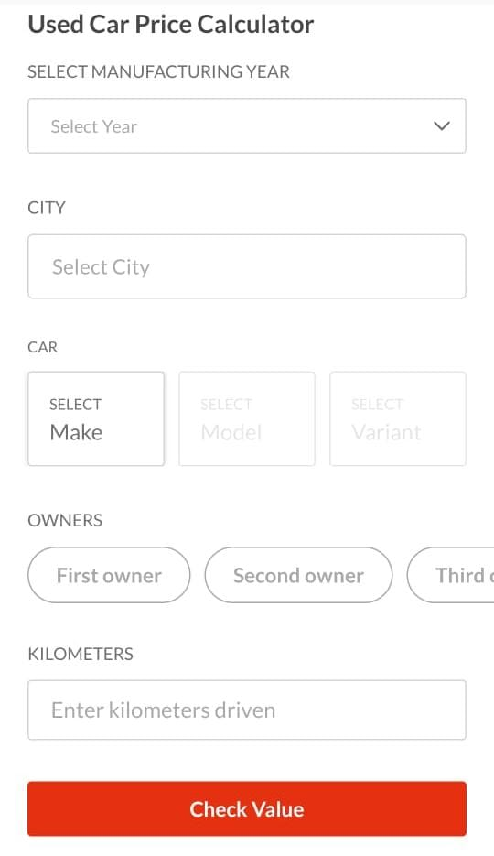
Websites Are Used To Predict The Price Of Used Cars
Kelley Blue Book (KBB)
Edmunds
NADA guides
Autotrader
Cars.com
CarGurus

Slide 8
CARWALE : Car wale is the best website to determine the value of your used car since we use data from millions of genuine buyers & sellers across the country in our pricing models to determine the most accurate prices for your used car

Slide 9
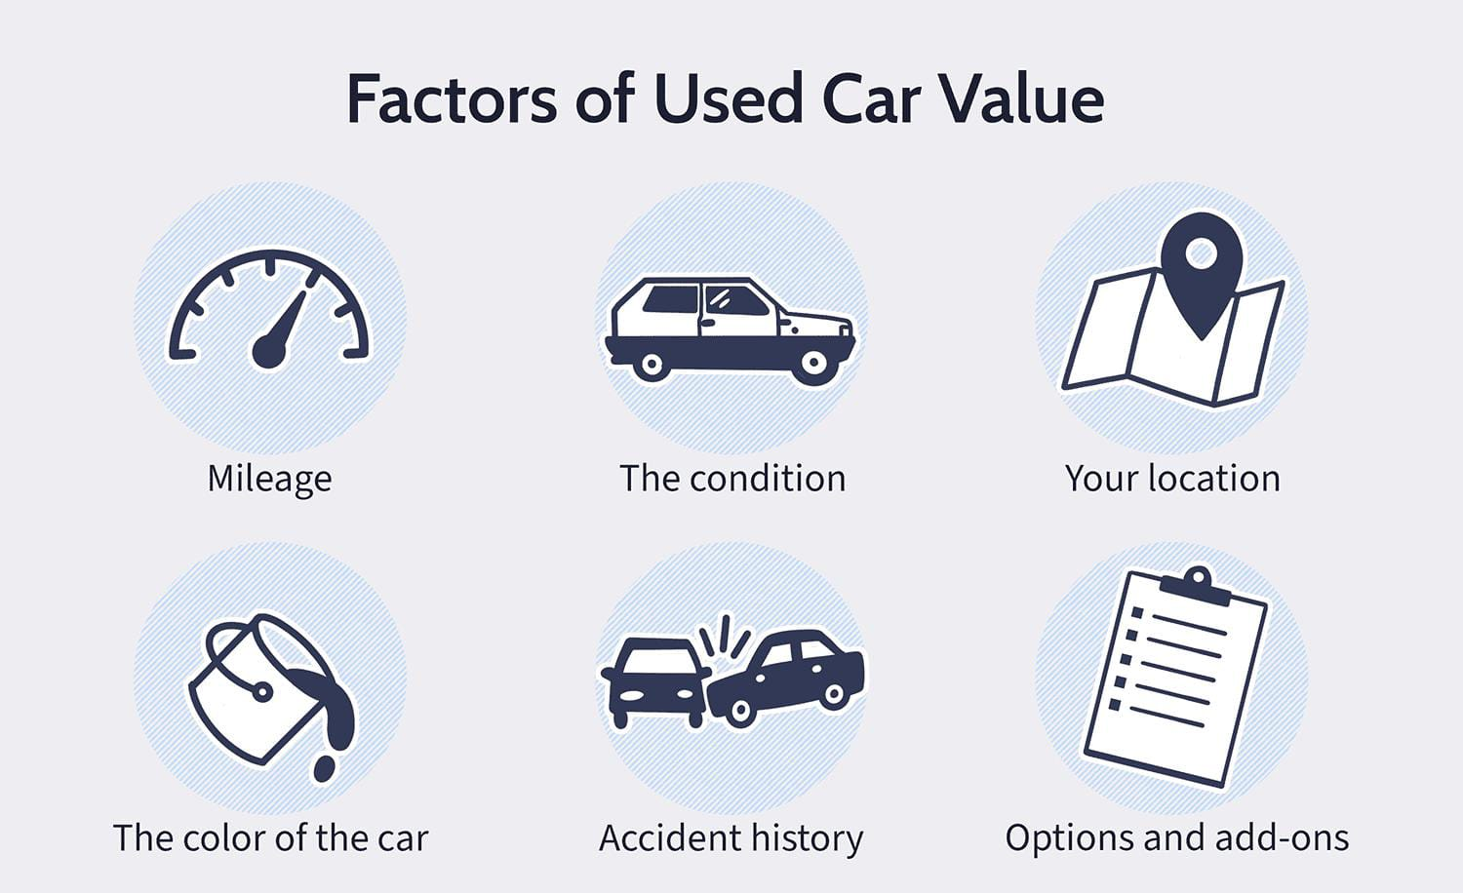
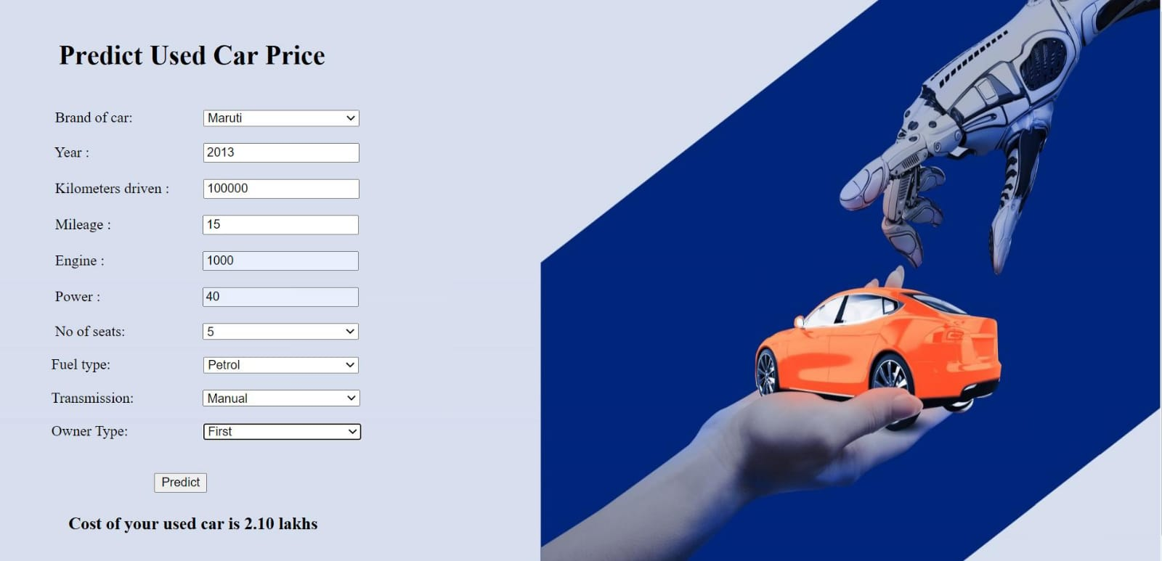
THE IMPACT OF PREDICTIVE PRICING

Slide 10
ALGORITHM
Multilinear Regression :
The role of multilinear regression in car price prediction is to analyze multiple factors such as car age , mileage , brand , model , and features to predict the price of a car accurately . It helps in understanding how each variable contributes to the overall price and enables informed decision-making for buyers , sellers , and industry professionals.

Slide 11
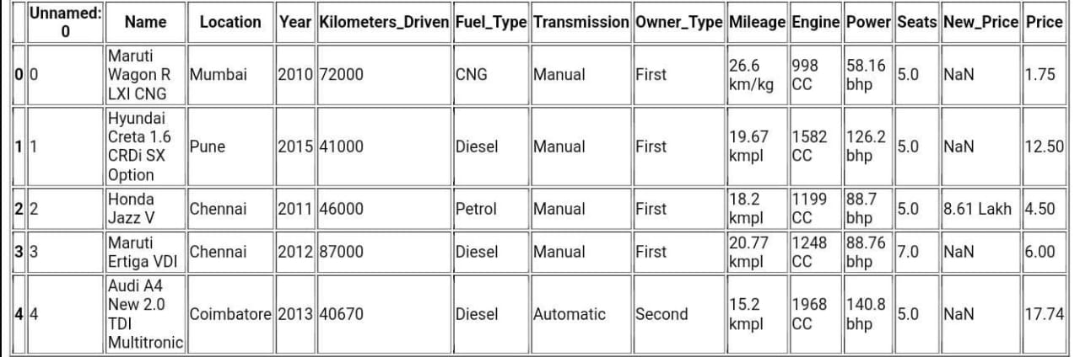
ANALYSIS : FUTURE OF CAR PRICING

Slide 12
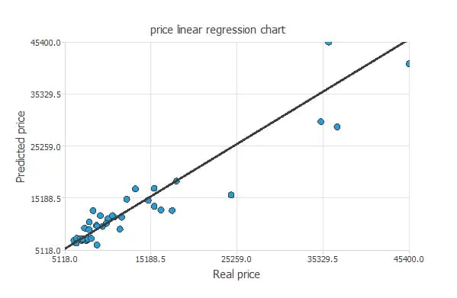



GRAPH
]

Slide 13
THANK YOU

